Slide 2
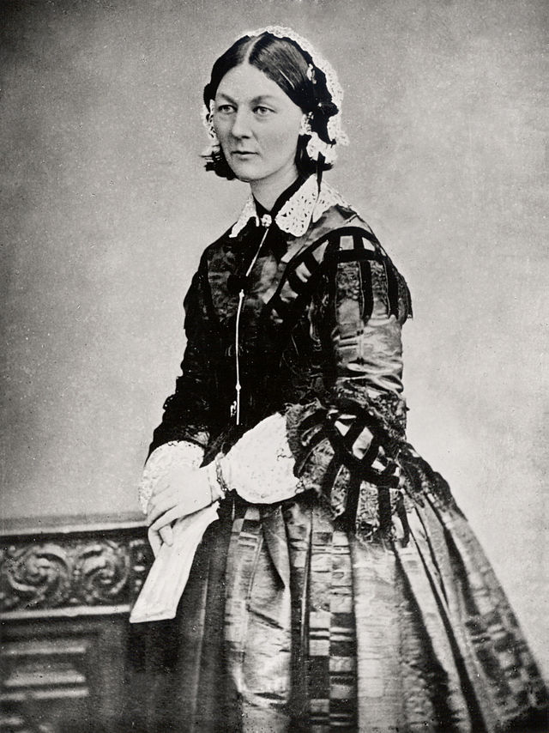
Florence Nightingale
Florence Nightingale is well known as the founder of modern nursing, particularly for her work during the Crimean War in the 1850s.
She is perhaps less well known for her use of statistics, although it is precisely this that underpinned the changes she instigated within nursing.

Slide 3
Florence Nightingale
In 1854, Nightingale led a team of nurses that she had trained to care for soldiers wounded in the Crimean war.
Death rates were very high, and Nightingale believed that this was largely due to the poor conditions, which included poor nutrition and a general lack of hygiene.
She and her team worked to improve diet, sanitation, morale, and general hygiene practices.

Slide 4
Florence Nightingale
Her experience in Crimea led Nightingale to campaign for improved conditions, and she used statistical diagrams to help display data she had collected to make a more persuasive argument.
This short activity looks at the diagrams she created and some alternative representations.

Slide 5

Florence Nightingale
On the following slide is the most famous of Nightingale’s diagrams and the key text, in case it is difficult to read.
Look at the diagrams and spend a few minutes making sense of them.
What do the diagrams show?
What might people misunderstand about the diagrams?

Slide 6
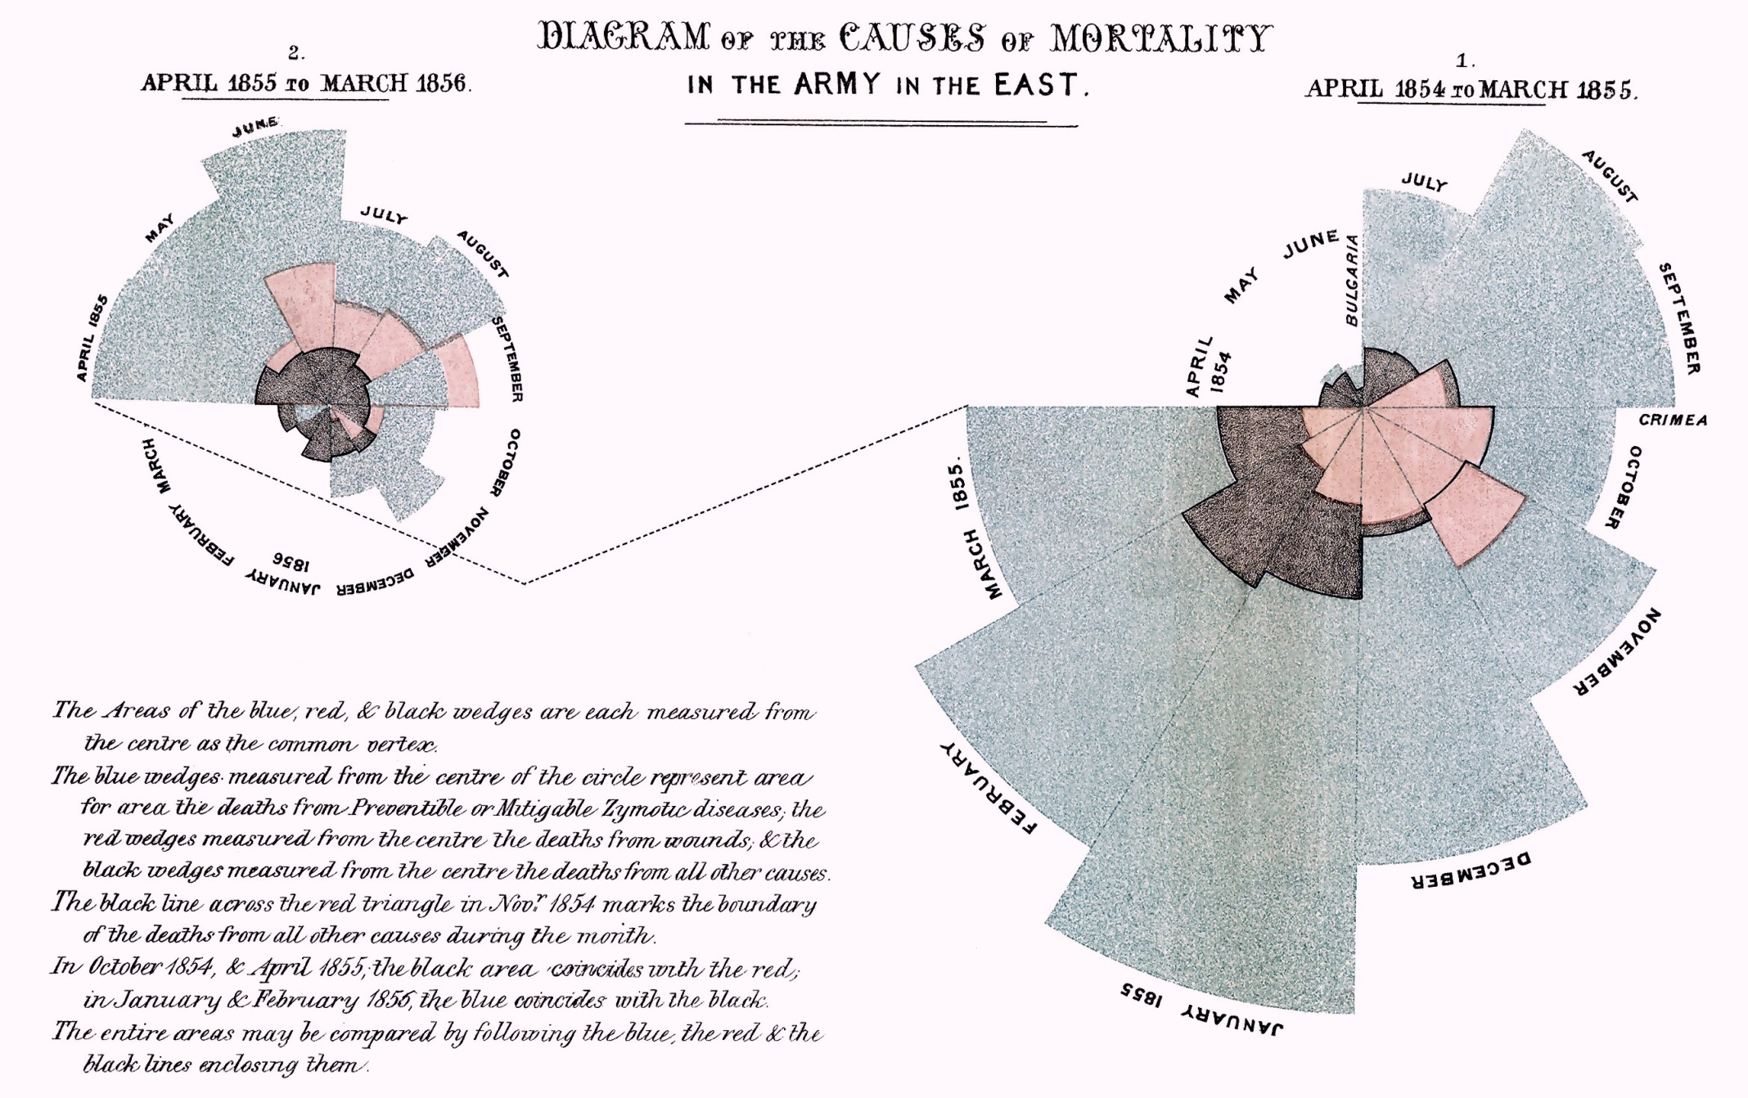

Slide 7
The key text:
The blue, red and black wedges are each measured from the centre as the common vertex.
Blue: preventable disease
Red: death from wounds
Black: all other causes
November 1854: black line shows where deaths from other causes is.
October 1854 & April 1855: black and red coincide

Slide 8
Understanding the diagrams
The area of each wedge represents the number of soldiers who died from the 3 causes.
Wedges are overlaid, with blue on the bottom, then black and then red on top. This means that some wedges cannot be seen at all. It also means that it is not possible to see the entire blue wedge at any time.
Do you think this might mislead people?

Slide 9
Previous diagrams
In an earlier diagram, Nightingale had made the radius of a wedge proportional to the number of people in the section.
She decided that this could be misleading.
Why do you think this was?

Slide 10
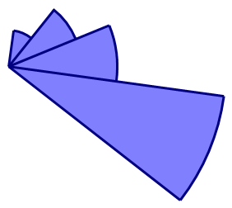
Previous diagrams
How many times larger does each section look compared to the smallest one?
Would this be a fair diagram if the sections are to represent 1000, 2000, 3000 and 6000 soldiers respectively?

Slide 11
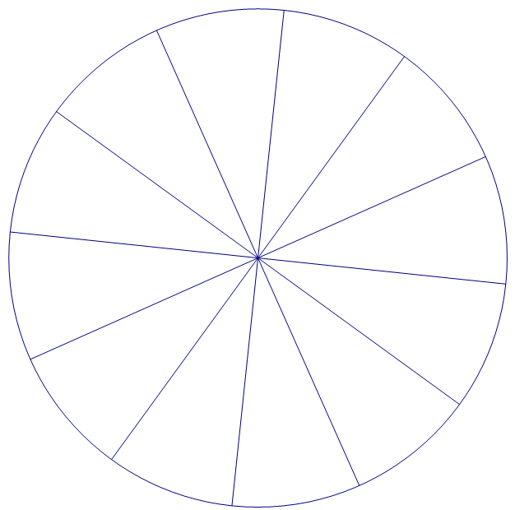

Polar Area diagrams
How would you draw a fair diagram to represent 1000, 2000, 3000 and 6000 soldiers respectively?
Accurately draw 4 wedges on the diagram to represent this.

Slide 12
Other diagrams
On the following slides this data set was used to create the statistical diagrams. Comment on them.
 | Blue | Red
January | 1 | 2
February | 2 | 5
March | 3 | 7
April | 4 | 5
May | 5 | 4
June | 6 | 1

Slide 13
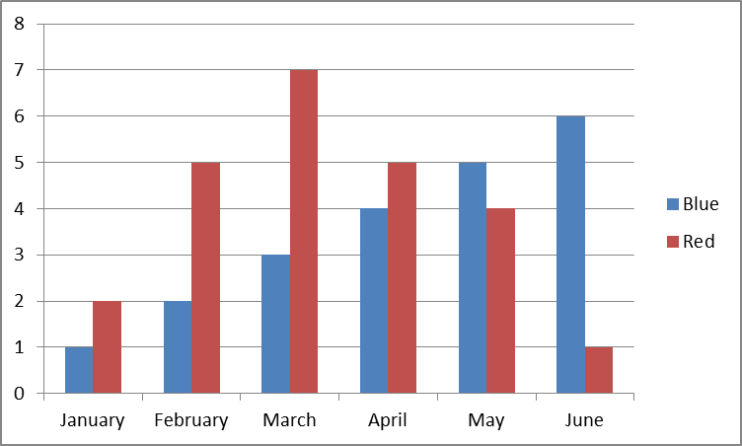
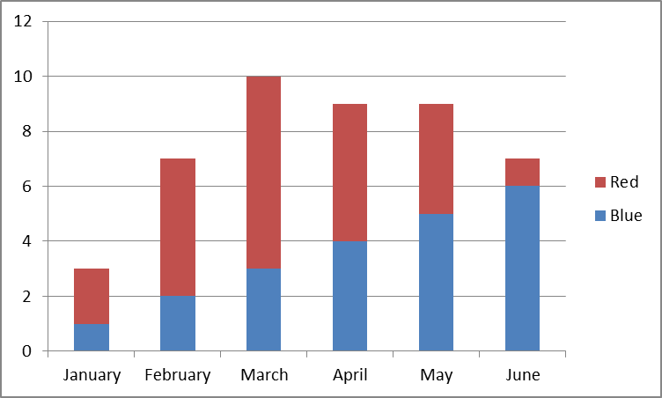

Other diagrams

Slide 14
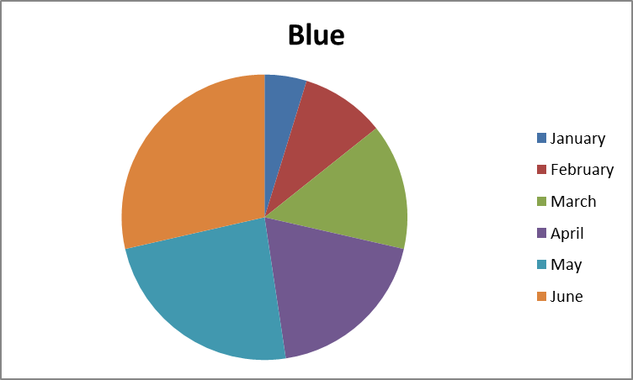
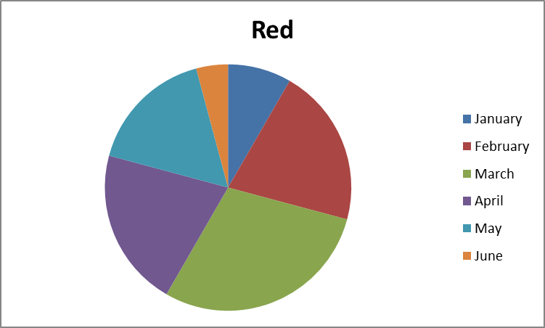

Other diagrams

Slide 15
Polar Area diagrams
Create a Polar area diagram for the data, similar to the ones that Nightingale created. One colour wedge should consistently overlay the other colour wedge.
Which months cause issues in doing this?

Slide 16
Polar Area diagrams

Slide 17
Area diagrams
Can you also accurately create a diagram so that all parts of the area are visible, i.e. wedges are not overlaid, but radiate outwards?
Example shown.
Are there advantages to this diagram?
How difficult is it to create?

Slide 18
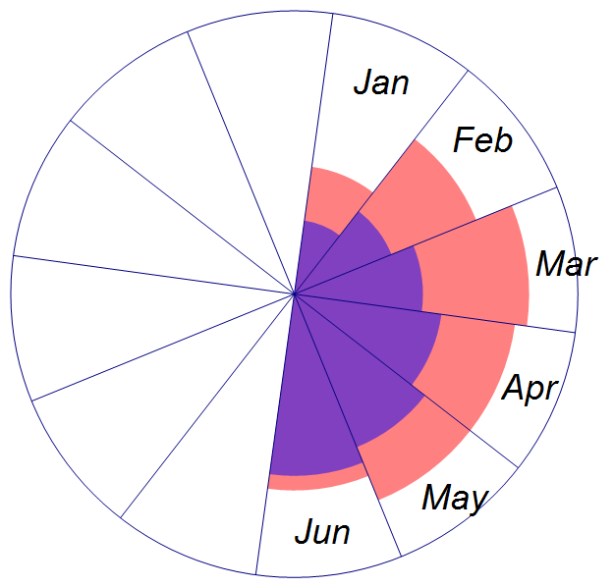
Area diagrams

Slide 20
Teacher notes: Florence Nightingale
This month’s edition looks at the statistical work of Florence Nightingale and then helps students consider different representations and how they can be misleading.
It would be helpful to print some colour copies of slide 6 to enable students to look closely at them
Much of the early part of this activity involves students thinking and discussing.
Slides 12-14 could be missed out with Higher attaining groups.

Slide 21
Teacher notes: Florence Nightingale
Slides 5-8
The diagrams show that as Nightingale and her team continued to improve hygiene and nutrition, so the rates of death from preventable diseases decreased. This gave weight to Nightingale’s assertion that these were fundamental to nursing care.
Potential difficulties with the Polar diagram:
Some wedges are hidden completely
Visually, the blue area could look smaller than it should since it is overlaid with the red and black sectors.
Similarly for the black area being overlaid with the red.
No scale, so although we can see that there are far more blue than black or red, these could be small numbers – which would still be worth reducing, but it would be more persuasive if there were an indication of numbers involved.

Slide 22
Teacher notes: Florence Nightingale
Slide 9
If the radius is used instead of the area, it looks far more dramatic a difference than it actually is. Where a length is doubled, the area is quadrupled. If a length is tripled, the area is 9 time bigger etc.
Slide 10
This diagram emphasises the visual discrepancies created when using the radius instead of the area.
On the diagram, the radii are in the ratio 1:2:3:6.
This means that the areas are in the ratio 1:4:9:36

Slide 23
Teacher notes: Florence Nightingale
Slide 11
Copies of the sheet ‘Polar Area Diagrams’ can be used, or students can construct the diagrams for themselves. 12 sectors are shown, representing the 12 months of the year that Florence Nightingale used.
The number of soldiers should be proportional to the area of the sector.
Area for 2000 soldiers = 2 x area for 1000 soldiers
π(R₂)² = 2π(R₁)²
(R₂)² = 2(R₁)²
The radii should be in the ratio 1: √2 : √3 : √6
Approximately 1 : 1.4 : 1.7 : 2.4
A radius of 2cm for the first one will fit in the outlines given.

Slide 24
Teacher notes: Florence Nightingale
Slides 12 -14
The comparative and component bar charts:
Both of these have scales, so it is easy to ascertain values.
It is possibly a little easier to ascertain proportions from a component bar chart, and a little easier to see trends in the individual items with a comparative bar chart.
Pie charts:
The data have to be shown on two pie charts in order to compare. It isn’t clear whether these are drawn to the same scale. No scale given so the viewer doesn’t know how many people the charts represent.
They do give a good sense of proportion.

Slide 25
Teacher notes: Florence Nightingale
Slides 15-16
Assuming that a radius of 1cm is used for 1:
If red is drawn first and then blue is laid on top, the issues arise when the blue radius exceeds the red, i.e. for May and June.
If blue is drawn first and then red is laid on top, issues arise for Jan, Feb, March, and April.
 | Blue | Radius | Red | Radius
January | 1 | 1.00 | 2 | 1.41
February | 2 | 1.41 | 5 | 2.24
March | 3 | 1.73 | 7 | 2.65
April | 4 | 2.00 | 5 | 2.24
May | 5 | 2.24 | 4 | 2.00
June | 6 | 2.45 | 1 | 1.00

Slide 26
Teacher notes: Florence Nightingale
Slide 17-18
Assuming that the blue is inside and the red is outside, an additional calculation is required to find the radius for the red section. Since the outside of the red section encompasses both red and blue, find the total. The red area is the difference between the total and the blue.
The advantages of this representation are that the whole of each colour is visible and it is easier to compare the overall totals.
 | Blue | Radius | Red | Red + Blue | Radius
January | 1 | 1.00 | 2 | 3 | 1.73
February | 2 | 1.41 | 5 | 7 | 2.65
March | 3 | 1.73 | 7 | 10 | 3.16
April | 4 | 2.00 | 5 | 9 | 3.00
May | 5 | 2.24 | 4 | 9 | 3.00
June | 6 | 2.45 | 1 | 7 | 2.65

Slide 27
Acknowledgements
Florence Nightingale Photograph and information from http://en.wikipedia.org/wiki/Florence_Nightingale#Crimean_War
Accessed 10/3/15

