Slide 1
Tuberculosis

Slide 2
TB as a Worldwide
Public Health Issue
World population ~ 6 billion
~ 1in 3 people in world infected
~ 9.4 million new cases of active TB/year
1.7 million deaths/year

Slide 3
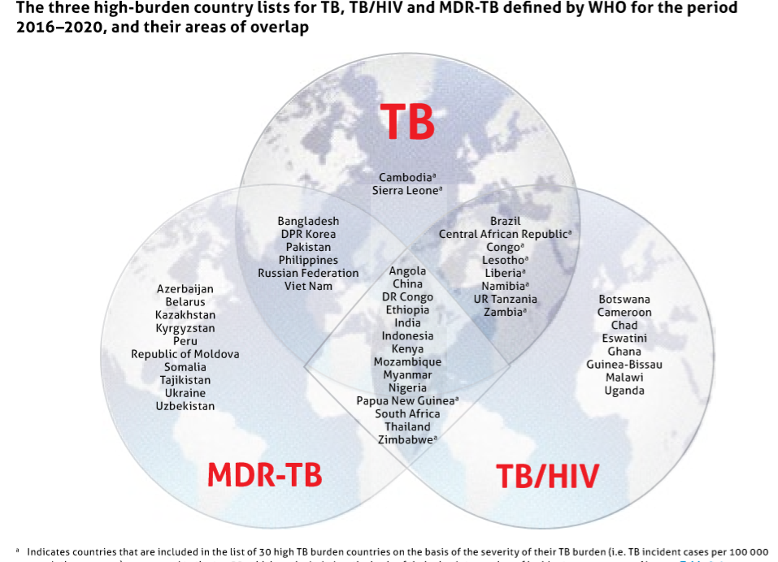

Slide 4
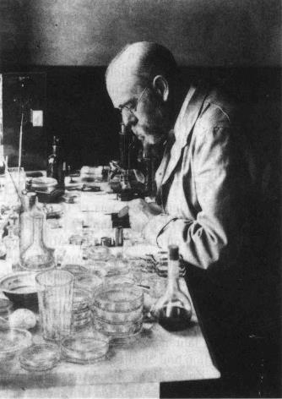
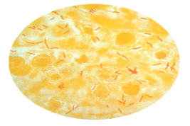
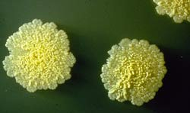
M tuberculosis as causative agent for tuberculosis
1882 – Robert Koch – “one seventh of all human beings die of tuberculosis and… if one considers only the productive middle-age groups, tuberculosis carries away one-third and often more of these…”
Robert Koch
1886

Slide 5
SITE-SPECIFIC MYCOBACTERIAL DISEASE. | MAJOR | LESS COMMON
PULMONARY | M.TUBERCULOSIS | M.BOVIS M.XENOPI MAC M.KANSASII M.MALMOENSE
LYMPH NODE | M.TUBERCULOSIS MYCOBACTERIUM AVIUM COMPLEX (M.SCROFULACEUM,M.INTRACELLULARE & M.AVIUM) | M.MALMOENSE M.BOVIS, M.FORTUITUM M.CHELONEI.
SOFT TISSUE/SKIN | M.LEPRAE M.ULCERANS | M.TUBERCULOSIS M.MARINUM M.FORTUITUM M.CHELONEI.
DISSEMINATED (SEEN IN IMMUNODEFICENT STATES) | MAC (HIV-ASSOCIATED) | M.HAEMOPHILUM BCG M.GENAVENSAE M.FORTUITUM M.CHELONEI. .

Slide 6
REASONS FOR INCREASING INCIDENCE
POVERTY.
POPULATION INCREASE.
LACK OF ACCESS TO HEALTH CARE.
LACK OF KNOWLEDGE.
CIVIL UNREST.
INEFFECTIVE TB CONTROL PROGRAMS.
SOCIAL DEPRIVATION (HOMELESS,IV DRUG ABUSER)
HIV.
DRUG RESISTANCE
IMMIGRATION FROM HIGH PREVALENCE AREAS.

Slide 7
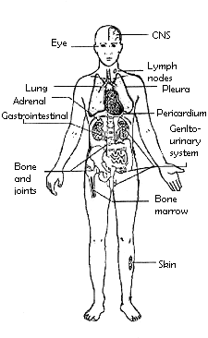
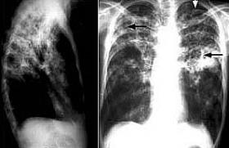
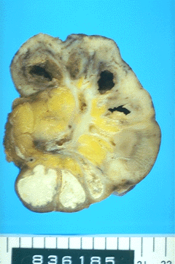
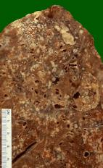
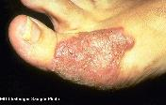
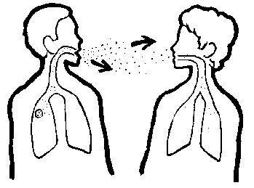
TB – A Multi-system Infection
PRIMARY TB: ORGANS INVOLVED: LUNGS, TONSILS, INTESTINE, SKIN

Slide 8
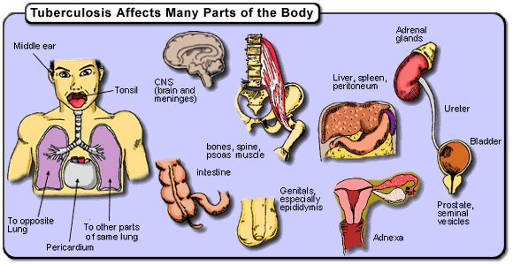
---

Slide 9
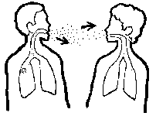
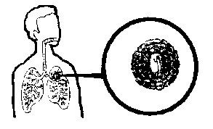


Natural History of TB Infection
Exposure to TB
No infection
(70-90%)
Infection
(10-30%)
Latent TB
(90%)
Active TB
(10%)
Never develop
Active disease
Untreated
Treated
Die within 2 years
Survive
Die
Cured

Slide 10
TIME TABLE FOR TB.
TIME FROM INFECTION | MANIFESTATION
3-8 weeks 3-6 months (3-12M) Upto 3 Years From 3 year onward (1-5 Yr) Around 8 years (average5-15) | PRIMARY COMPLEX TEST POSITIVE Meningeal,Miliary,Pleural dis. GIT,Bone & Joint,L/N disease Post prim; Dis due to reactivation or reinfection Genito-Urinary & Skin Lesion

Slide 11
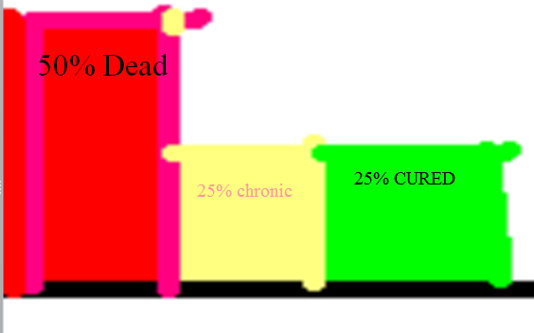
NATURAL HISTORY OF UNTREATED TB.
Without treatment, after 5 years - 50% of pulm. TB pts will die.
25% self-cured by there strong immune response.
25% will remain ill with chronic, infectious TB.

Slide 12
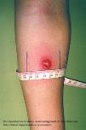
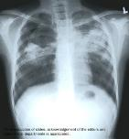

Latent TB vs. Active TB
Latent TB (LTBI) (Goal = prevent future active disease)
= TB Infection
= No Disease
= NOT SICK
= NOT INFECTIOUS
Active TB (Goal = treat to cure, prevent transmission)
= TB Infection which has
progressed to TB Disease
= SICK (usually)
= INFECTIOUS if PULMONARY (usually)
= NOT INFECTIOUS if not PULMONARY (usually)

Slide 13
TIME TABLE FOR TB.
TIME FROM INFECTION | MANIFESTATION
3-8 weeks 3-6 months (3-12M) Upto 3 Years From 3 year onward (1-5 Yr) Around 8 years (average5-15) | PRIMARY COMPLEX TEST POSITIVE Meningeal,Miliary,Pleural dis. GIT,Bone & Joint,L/N disease Post prim; Dis due to reactivation or reinfection Genito-Urinary & Skin Lesion

Slide 14
FATE OF INFECTION
Most prim;infection heals with or without calcification of primary complex.
Hematogenous spread …via lymphatic... seeding of tubercle bacilli to other parts of lungs as well as other organs.
Infection usually contained at pulm. & extra pulm;sites.
Potential for reactivation of infection at all sites is present

Slide 15
RISK OF PROGRESSION OF INFECTION TO DISEASE
Once infected, stays infected for many years, probably for life.
Approx.90% Do Not develop TUBERCULOSIS (asymptomatic, but INFECTED - POSITIVE TST (PPD).
Infected individuals can develop TB disease at any time.
Chance of dvlping dis; is greatest shortly after infection and then steadily lessens as time goes by.
The most important trigger is weakening of immune resistance.

Slide 16
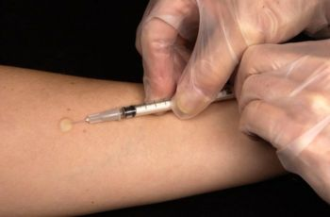
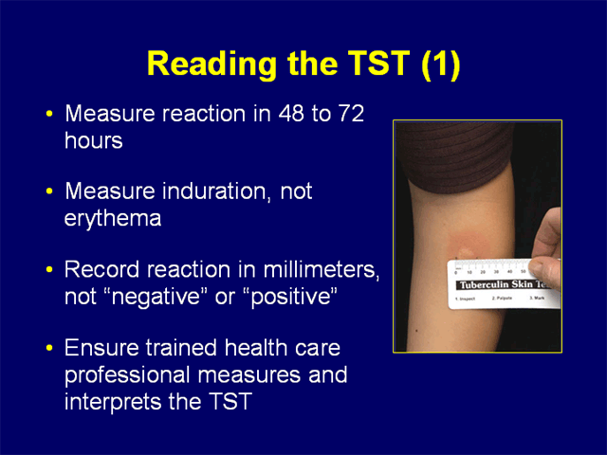
Screening for TB
“ppd” the Mantoux Tuberculin Skin Test (TST)
Delayed-type hypersensitivity reaction
Induration, NOT erythema
Most common TB test
  Best supportive data
  Established thresholds
Not ideal test
  False positive results
  False negative results
  Poor follow-up compliance

Slide 17
Screening for TB
Anergy
Inability to react to TST
Impaired immune response to delayed-type hypersensitivity reaction (Type IV)
Most common with highest risk groups
  prolonged corticosteroids
  recent immunomodulators
  current chemotherapy
  HIV infection

Slide 18
Screening for TB
Boost Phenomenon / Two-Step Testing
Initial TST false negative
Occurs following long latency between infection and testing
  “hibernating” immune response
TST reactivates immune response
  subsequent tests positive
Common, ~20%
2 step testing recommended for high risk
  TST repeated in 2 weeks

Slide 19
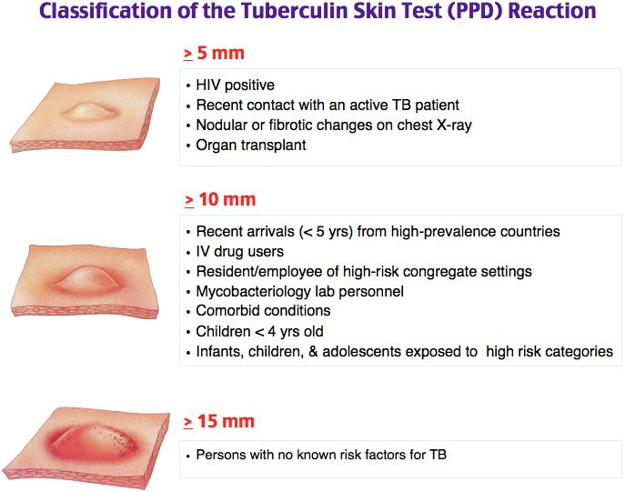

Slide 20
Tuberculin Skin Test
Positive Result
≥ 5 mm induration
HIV infection
Recent contact active TB
CXR - prior TB (fibrotic changes)
Immunosuppressive therapy
  Organ transplant recipients
  Corticosteroids (>15mg prednisone/day)
  TNF-α antagonists

Slide 21
Tuberculin Skin Test
Positive Result
≥ 10 mm induration
Converters (>10mm change within 2 years)
Recent immigrants from endemic region
High risk settings
Targeted chronic medical disorders
  Diabetes Mellitus
  ESRD
  Leukemia/lymphoma
  Head, neck, lung cancer
  Silicosis
  Gastrectomy
  ≤ 90% ideal body weight
  Health care workers
  Chronic care facility
  Prisoners and prison workers
  Homeless and homeless shelter workers

Slide 22
Tuberculin Skin Test
Positive Result
≥ 15 mm induration
All others
Avoid testing in this group
High false positive rate

Slide 23
Tuberculin Skin Test
False Positive Results
Nontuberculosis mycobacteria
  Typically < 10 mm
BCG administration
  Positive ppd for 5-10 years
Reading erythema instead of induration

Slide 24
Tuberculin Skin Test
False Negative Results
Reading erythema instead of induration
Immunocompromised / Anergy
Inappropriate test administration/reading
Recent infection (2-12 wks to convert TST)
Extremes of age
Boost phenomenon
Live viral immunization (measles, smallpox)
Overwhelming active TB infection
A negative ppd DOES NOT rule-out active disease

Slide 25
Screening for TB
Diaskin test
intradermal test with recombinant tuberculosis allergen;
Contains immunodominant antigens ESAT-6 and CFP10 specific to MTB;
Is negative in case of sensitization by BCG immunization and NTM infection, which is a factor when using TST.

Slide 26
QUANTIFERON GOLD TEST
QFT-Gold test measures interferon-gamma in the testee's blood after incubating the blood with specific antigens from M. Tuberculosis proteins, especially for latent TB infection testing

Slide 27
PRIMARY PULMONARY TUBERCULOSIS
PRIMARY TUBERCULOSIS: THE FIRST INFECTION WITH THE MYCOBACTERIUM TUBERCULOSIS.
IT USUALLY INCLUDES INITIAL LESION AND DRAINING LYMPH NODES.

Slide 28
Prim Pulm TB.
LUNGS ARE MOST COMMON SITE OF INFECTION.
ALL LOBAR SEGMENTS ARE AT EQUAL RISK OF BEING SEEDED BY INHALED INFECTED DROPLETS.
25% OF CASES - MAY BE MORE THAN ONE PRIMARY FOCUS.

Slide 29

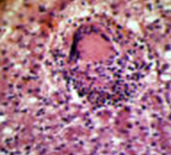
TB Invades/Infects the Lung
Effective immune
response
Infection limited
to small area of lung
Immune response
insufficient

Slide 30
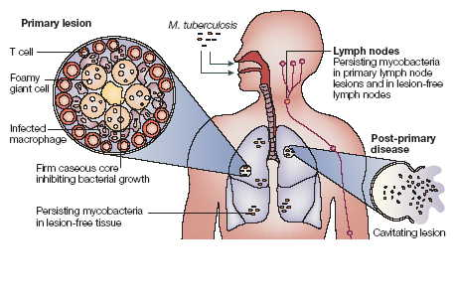

Slide 31
Pathology of pulmonary TB.
PRIMARY OR GHON FOCUS
PRIMARY OR GHON COMPLEX
PRIMARY INFECTION IS USUALLY EVIDENT AS A SUBPLEURAL TUBERCLE CALLED AS GHON FOCUS
IT MAY BE IN ANY LUNG ZONE
GHON FOCUS + DRAINING HILAR L/N

Slide 32
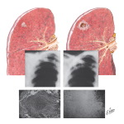

Slide 33
Clinical Features of Prim. Pulm. TB
Asymptomatic … A great majority especially adults.
Brief febrile illness. At the time of tuberculin conversion.
Occasionally, typical prim. Tb may occur in elderly people who have lost their tuberculin sensitivity.
In few cases with more severe infection or low host resistance, the child may be unwell, with anorexia, failure to gain weight.
Cough (if L/N or Granulation tissue impinge on Bronchial wall)
Wheeze
Sputum….rare in children.
Crept-s.
Other signs according to complications.

Slide 34
FEATURES OF PRIMARY TB
INFECTION (4-8 WEEKS)
INFLUENZA LIKE ILLNESS TST CONVERSION PRIMARY COMPLEX
DISEASE
LYMPHADENOPATHY COLLAPSE CONSOLIDATION OBSTRUCTIVE EMPHYSEMA CAVITATION PL EFFUSION ENDOBRONCHIAL LESION MILIARY MENINGITIS PERICARDITIS
HYPERSENSITIVITY
ERYTHEMA NODOSUM PHLECTENULAR CONJUNCTIVITIS DACTILITIS

Slide 35
Tests may include:
Tuberculin skin test (also called a PPD test)
Diaskin test
Interferon-gamma release blood test such as the QFT-Gold test to test for TB infection
Sputum examination (stain and cultures – solid and liquid media, molecular-genetic testing - PCR)
Chest x-ray
Chest CT scan
Bronchoscopy
Thoracentesis
Biopsy of the affected tissue (rare)

Slide 36
Diagnosis of primary pulmonary Tuberculosis
HISTORY: contact +, vague ill health, brief febrile / subfebrile illness, cough over 3 wks, hemoptysis, anorexia, unintended weight loss; ausc. - crepts, wheeze…
TST +ve, Diaskin test +ve
QFT-Gold test (T-spot Tb test): +ve
CXR changes unilateral or bilateral Hilar, Paratracheal L/N, parenchymal lesions - consolidation, collapse, dissemination, cavities; pleural effusion…
SPUTUM (AFB+), rarely produced in children
GASTRIC WASHING for AFB C/S (POSITIVE IN 20-25% CASES)
Gene Xpert-Rif: PCR (Mycobacterial DNA amplification techniques, resist. to rifamp. detection – MDR Tb)

Slide 37
Sputum Smear Preparation (ward)
Specimens should be sent to the lab immediately to preserve the quality of the specimens
Always aim for three specimens at each exam
Always store at a cool temperature and away from sunlight to preserve the quality of specimens
3 respiratory specimens will detect 90% of smear-positive cases

Slide 38
Sputum Smear Preparation (lab)
1. Homogenization;
2. Decontamination;
3. Concentration.
AFB testing is to be performed
with CONCENTRATED specimen

Slide 39
AFB TESTING METHODS
1. AFB smear-microscopy (Ziegl-Neelsen stain);
2. Culture (solid and liquid media) + sucseptibility / resistance to anti-tuberculosis agents;
3. Gene Xpert-Rif (molecular-genetic testing).

Slide 40
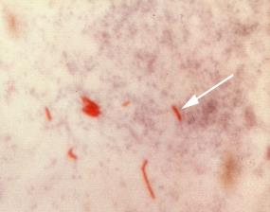
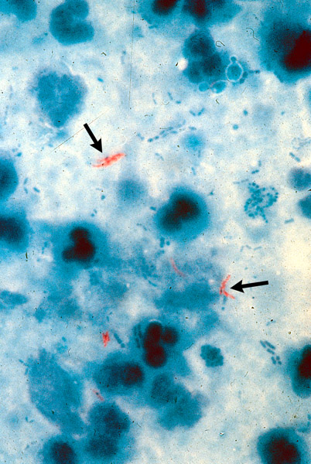
AFB smear-microscopy
(Ziegl-Neelsen stain) - 1
Acid-fast bacilli (AFB) are shown in red

Slide 41
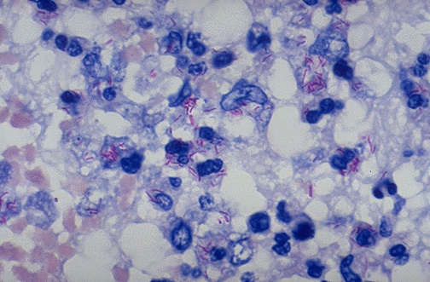
AFB smear-microscopy (Ziegl-Neelsen stain) - 2

Slide 42
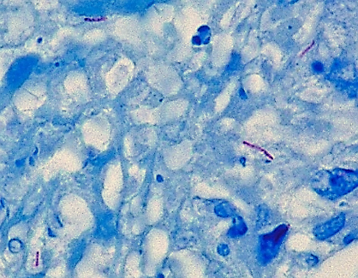
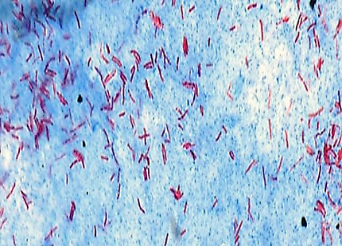
AFB smear-microscopy (Ziegl-Neelsen stain) - 3

Slide 43
Smear-positive PTB vs.
Smear-negative PTB-
PTB+ (Pulmonary TB smear-positive)
  One AFB-positive smear; i.e. any patient with at least one positive smear result (irrespective of quantity of AFBs seen on microscopy)
PTB- (smear-negative)
  Any pulmonary TB case that does not meet the definition of being smear-positive. This includes:
  1. Patients with three negative smear results and radiological findings and doctor’s decision to treat for TB
  2. Patients with negative smear results and a positive culture result for M. tuberculosis
  3. Patients who are unable to produce sputum and with highly suspicious radiological and clinical findings and doctor's decision to treat for TB
  Recommendations to improve the diagnosis of smear negative pulmonary and extrapulmonary TB among adults in HIV prevalent and resource constrained settings.
  Draft for discussion by Strategic and Technical Advisory Group of Stop TB Department of WHOJune 2006

Slide 44
Radiological features
In adults CXR changes (lung component of prim complex) + at time of TST conversion (7-30%)
In children –CXR---- Hilar >Paratracheal or Both OR B/L Hilar Lymphadenopathy & Parenchymal lesion.
Segmental or lobar consolidation or obstructive emphysema on CXR.
Radiological abnormality may persist upto 6 months ater diagnosis. But complete resolution after 2 year.
Calcification may occur

Slide 45
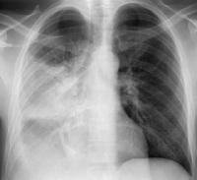
CONSOLIDATION
Enlarged tuberculous L/N.at hilum.
Upper / Middle lobe is most often affected.
Radiological appearances are due to:
1 collapse..
2 inflammatory exudation..
3 caseous pneumonia
Cough
Dullness
Bronchial breathing (diminished)
Crepts, Asphyxia in children
+-resulting in death

Slide 46
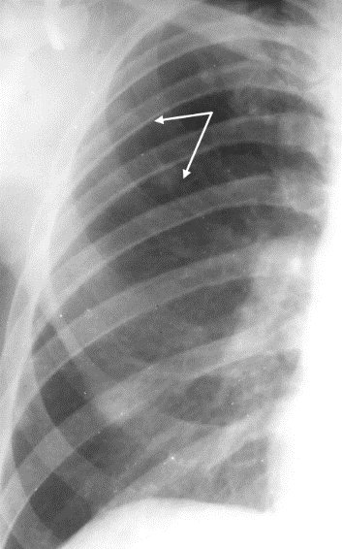
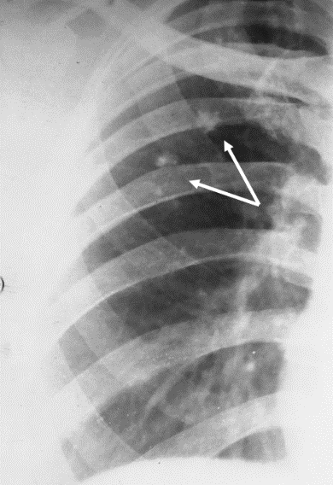
CXR IN PRIMARY TB EVOLUTION
(fine infiltration – fibrosis – calcification)

Slide 47
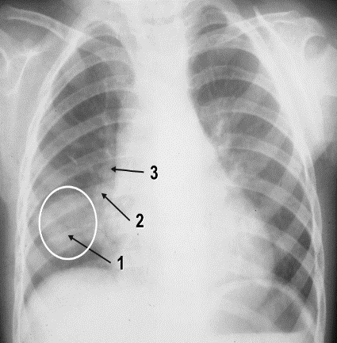
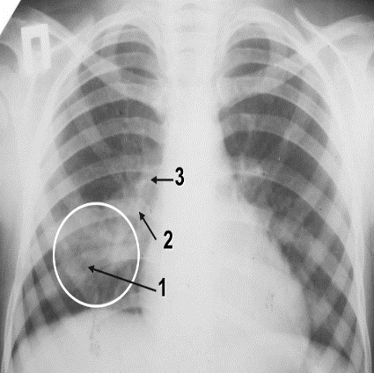
CXR IN PRIMARY TB EVOLUTION

Slide 48
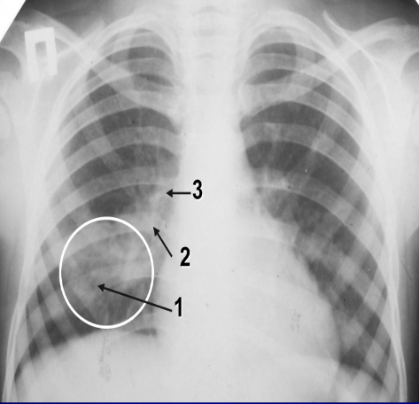
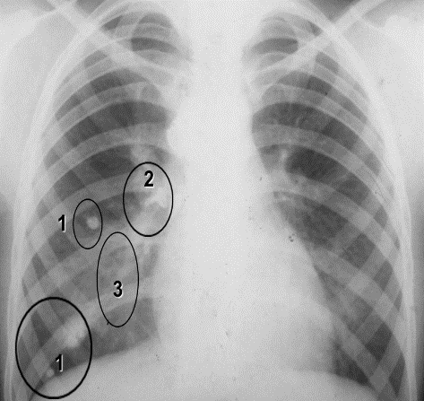
GHON’S and RANKE’S COMPLEX
CXR IN PRIMARY TB EVOLUTION

Slide 49
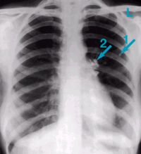
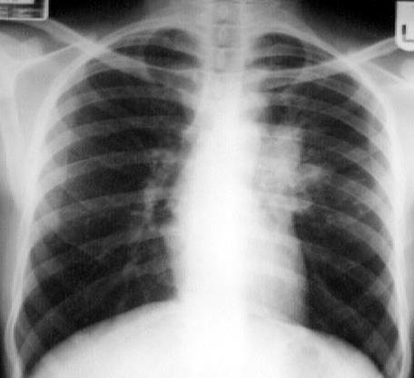
CXR IN TB (CONT-D)

Slide 50
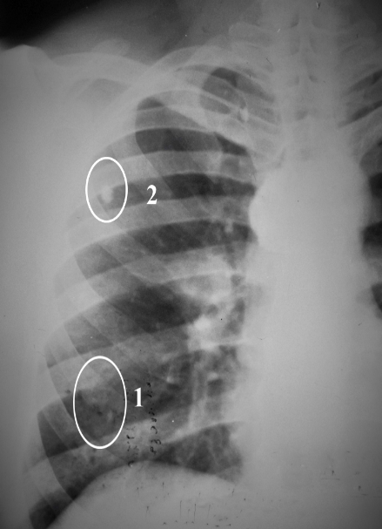
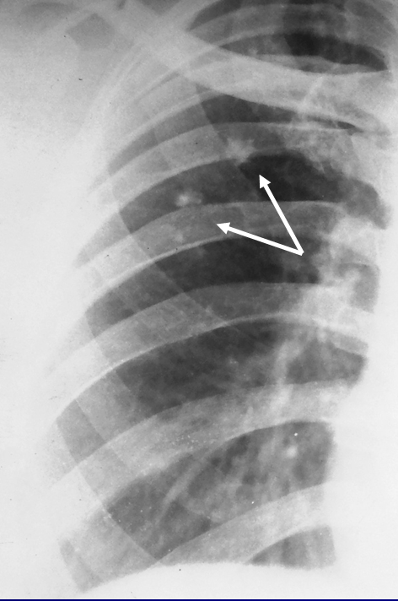
CXR IN TB (CONT-D)

Slide 51
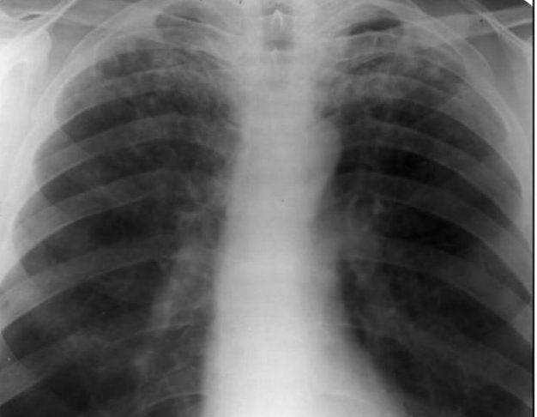
CXR IN TB (CONT-D)

Slide 52
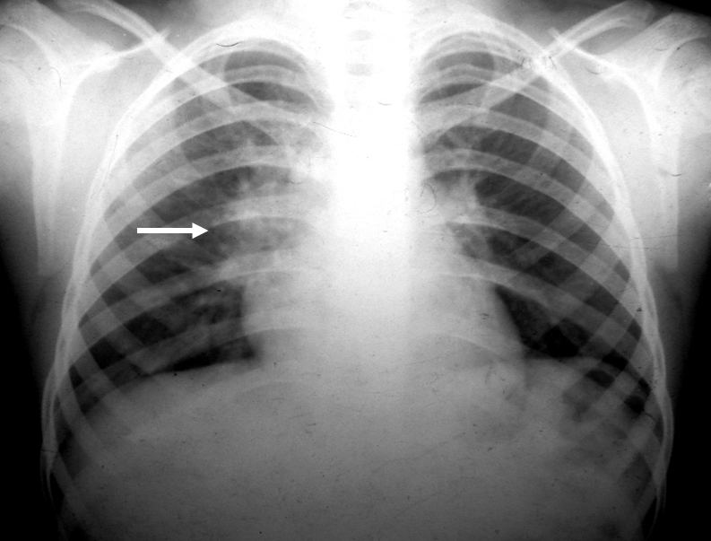
CXR IN TB (CONT-D)

Slide 53
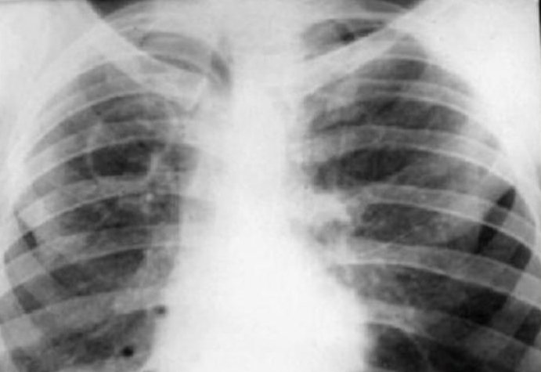
CXR IN TB (CONT-D)

Slide 54
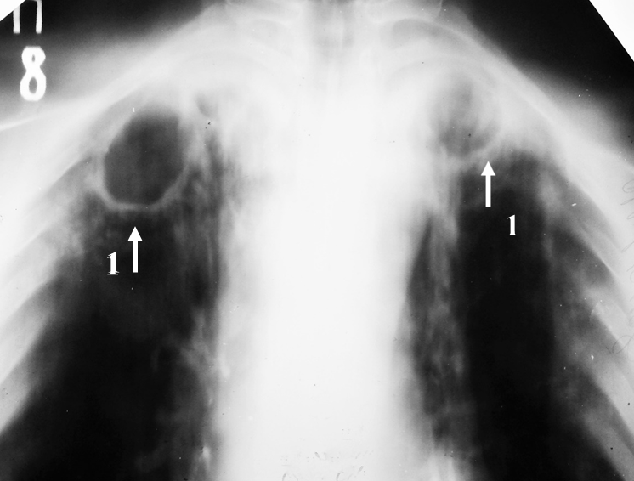
CXR IN TB (CONT-D)

Slide 55
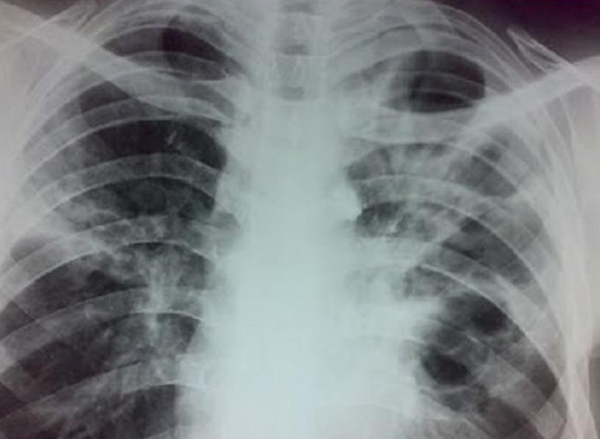
CXR IN TB (CONT-D)

Slide 56
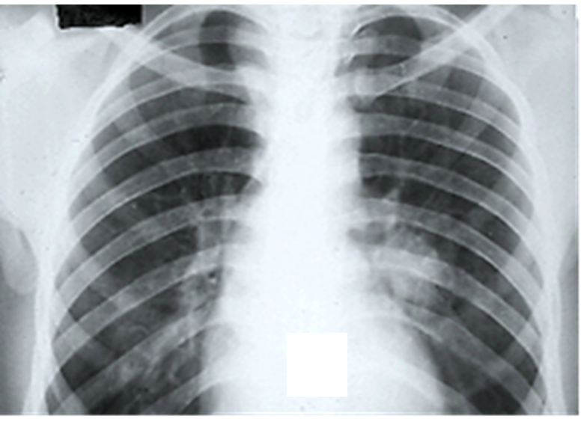
CXR IN TB (CONT-D)

Slide 57
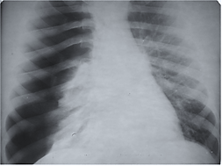
CXR IN TB (CONT-D)

Slide 58
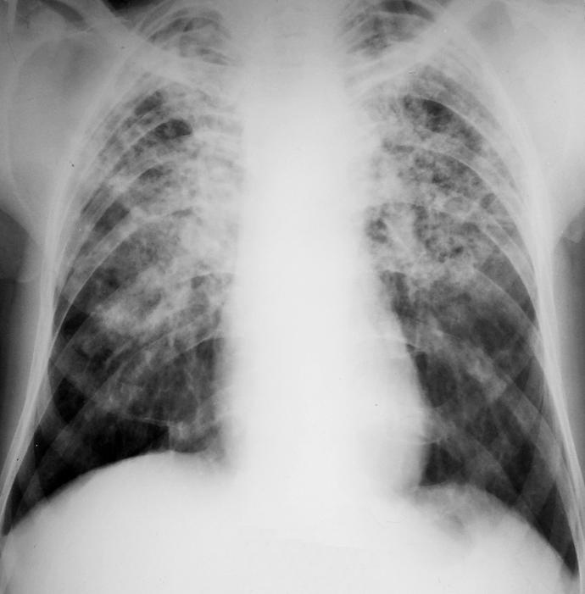
CXR IN TB (CONT-D): DISSEMINATED TB

Slide 59
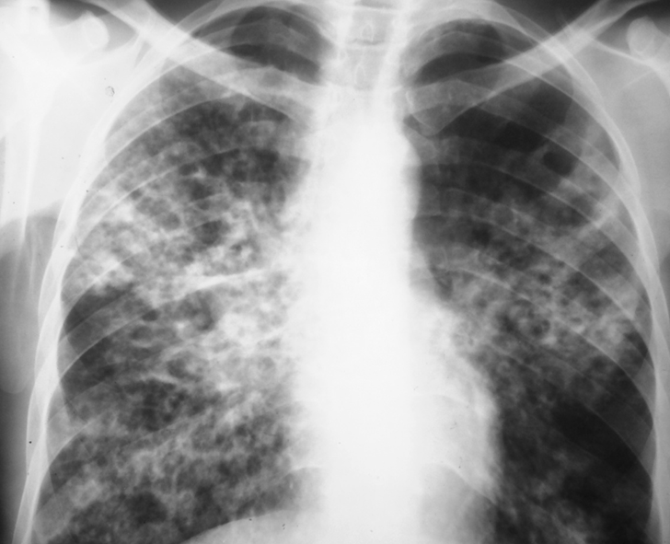
CXR IN TB (CONT-D): DISSEMINATED TB

Slide 60
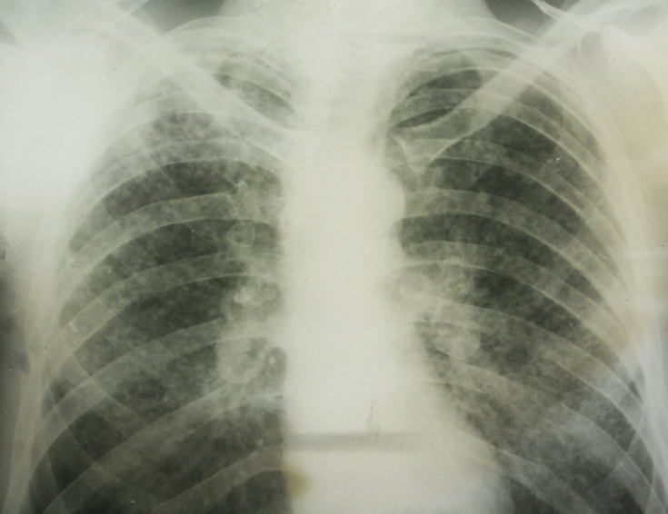
CXR IN TB (CONT-D) : DISSEMINATED TB

Slide 61
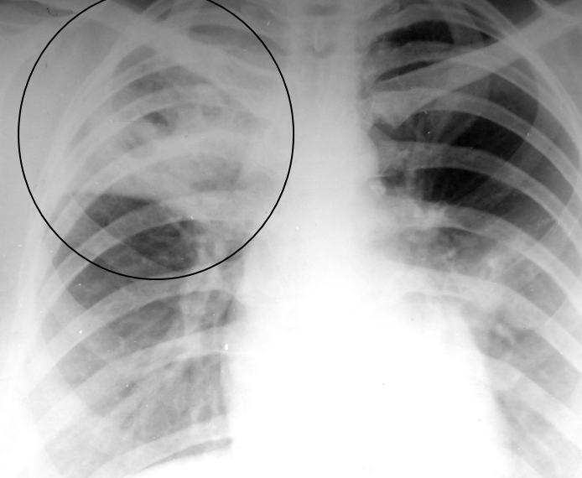
CXR IN TB (CONT-D) : DISSEMINATED TB

Slide 62
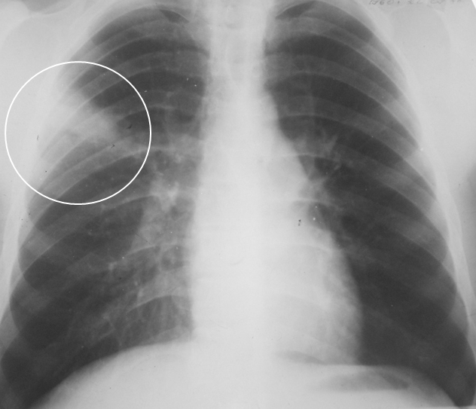
CXR IN TB (CONT-D)

Slide 63

CXR IN TB (CONT-D)

Slide 64
CXR IN TB (CONT-D)

Slide 65

CXR IN TB (CONT-D)

Slide 66

CXR IN TB (CONT-D)

Slide 67


CXR IN TB (CONT-D)

Slide 68

Miliary TB
Result of acute diffuse dissemination of tubercle bacilli via blood-stream.
Form of severe infection
Symptoms—fever, night sweats, anorexia, wt;loss, dry cough,
Signs-------hepatosplenomegaly, chest normal to diminished breathing and crepts,
CXR—1-2 mm millet seeds shadow through lung feild
Fundoscopy – choroidal tubercles (5-10%)

Slide 69

Miliary TB (recent)

Slide 70

Miliary TB (recovery)

Slide 71

Pleural effusion
USUALLY OCCURS IN 3-6 MONTHS AFTER INFECTION.

Slide 72


Slide 73
OUTCOME OF PRIMARY INFECTION
NO CLINICAL DISEASE;
POSITIVE TST; USUAL OUT COME =90% OF CASES.
2. HYPERSENSITIVITY REACTIONS
ERYTHEMA NODOSUM
PHLYCTENULAR CONJUNCTIVITIS DACTYLITIS
3. PULM. AND PLEURAL COMPLICATIONS
TB PNEUMONIA, LOBAR COLLAPSE, PL EFFUSION
DISSEMINATED DISEASE .
LYMPHADENOPATHY (USUALLY CERVICAL) MENINGITIS,
PERICARDITIS, MILIARY DISEASE.

Slide 74

COMPLICATIONS OF PRIMARY TB-1
ATELECTASIS
PLEURAL EFFUSION, PERICARDITIS, POLYSEROSITIS
PNEUMOTHORAX
BRONCHIECTASIS
OBSTRUCTIVE EMPHYSEMA
ERYTHEMA NODOSUM
PHLYCTENULAR CONJUNCTIVITIS
PONCET’S DISEASE

Slide 75
COMPLICATIONS -2
Bones. Spinal pain and joint destruction may result from TB that infects your bones (TB spine or potss spine)
Brain (meningitis)
Liver or kidneys
Heart (cardiac tamponade)
Pleural effusion
Tb pneumonia
Serious reactions to drug therapy (hepato toxicity; hypersentivity)

Slide 76

Erythema nodosum
A manifestation of hypersensitivity reaction.due to vasculitis in deep dermis & skin fat.
Tender,dusky-red nodular lesions on anterior surface of legs>ant surface of thighs,>extensor surface of forearms>face.breast.
5-20 mm diameter nodule
Illdefined margin
Resolve over a week or two.
Red>purple>brown
Recurrent crops
Ass with fever positive
TST recurrent crops of lesions
may occur.

Slide 77


Erythema nodosum

Slide 78

VASCULITIS

Slide 79

Phlyctenular conjunctivitis
Reflects hypersensitivity to the tubercle bacilli.
Usually seen in first year of infection.
Common in children.
Usually in one eye.
Begin with LACRIMATION,IRRITATION,or PHOTOPHOBIA.
1-3 mm shiny yellowish or grey bleb and the limbus,with a sheaf of dilated vessels running out toward it from edge of conjunctival sac.

Slide 80
TB MENINGITIS (TBM)
OCCURS SHORTLY AFTER A PRIM; INFECTION IN CHILDHOOD OR AS PART OF MILIARY TB
USUAL LOCAL SOURCE OF INFECTION IS A CASEOUS FOCUS IN THE MENINGES OR BRAIN ADJ; TO CSF PATHWAY.
BRAIN COVERED BY A GREENISH ,GELATINOUS EXUDATE, ESPECIALLY AROUND THE BASE
NUMEROUS SCATTERED TUBERCLES + ON MENINGES.

Slide 81
SYMPTOMS OF TBM
HEADACHE
VOMITING
LOW-GRADE FEVER
LASSITUDE
DEPRESSION
CONFUSION
BEHAVIORAL CHANGES

Slide 82
SIGNS OF TBM
MENINGISM + -
OCULOMOTOR PALSIES
PAPILLOEDEMA
DEPRESSION OF CONSCIOUS LEVEL
FOCAL HEMISPHERE SIGNS

Slide 83
INVESTIGATIONS FOR TBM.
ROUTINE INCLUDING CXR
CSF RE (INCREASED PRESSURE,USUALLY CLEAR BUT WHEN ALLOWED TO STAND A FINE CLOT “SPIDER WEB” MAY FORM)
CSF CHEMISTRY (INC PROTEINS & DEC.GLUCOSE).
CSF SMEAR AFB-TESTING (AFB -+)
BRAIN CT (HYDROENCEPHALUS,MENINGEAL ENHANCEMENT, TUBERCULOMA )

Slide 84

PONCET’S DISEASE
(Poncet’s rheumathoid)
aseptic form of reactive (secondary) arthritis in patients with active TB;
polyarthritis can be associated with erythema nodosum in some cases;
resolution of the arthritis occurres in just a few days after start of anti-TB therapy

Slide 85
TB IN HIV
MORE LIKELY INFECTION AFTER EXPOSURE.
USUALLY PROGRESSIVE PRIMARY DISEASE AFTER INFECTION.
REACTIVATION OF LATENT INFECTION.
REINFECTION WITH NEW STRAIN.
REDUCED SMEAR-POS RATES IN PTB.

Slide 86
TB + HIV
LESS CAVITATION.
ATYPICAL CXR APPEARANCES.
MORE DISSEMINATED DISEASE.
MORE EXTRA PULM; INFECTION.
MORE RISK OF ADVERSE DRUG REACTIONS.

Slide 87
Treatment
Most TB is curable, but…
  Four or more drugs required for the simplest regimen
  6-9 or more months of treatment required
  Person must be isolated until non-infectious
  Directly observed therapy to assure adherence/completion recommended
  Side effects and toxicity common
    May prolong treatment
    May prolong infectiousness
  Other medical and psychosocial conditions complicate therapy
    TB may be more severe
    Drug-drug interactions common

Slide 88
MEDICAL MANAGEMENT
PULMONARY TB is treated primarily with antituberculosis agents for 6 to 12 months.
Pharmacological management
First line antitubercular medications
Streptomycin 15mg/kg
Isoniazid or INH(Nydrazid) 5 mg/kg(300 mg max perday)
Rifampin 10 mg/kg
Pyrazinamide 15 – 30 mg/kg
Ethambutol(Myambutol) 15 -25 mg/kg daily for 8 weeks and continuing for up to 4 to 7 months

Slide 89
Second line medications
Capreomycin 12 -15 mg/kg
Ethionamide 15mg/kg
Paraaminosalycilate sodium 200 -300 mg/kg
Cycloserine 15 mg/kg
Vitamin b (pyridoxine) usually adminstered with INH

Slide 90
Third line DRUGS
Other drugs that may be useful, but are not on the WHO list of SLDs:
Rifabutin
Macrolides:e.g.,clarithromycin (CLR)
Linezolid(LZD)
Thioacetazone(T)
Thioridazine
Arginine

Slide 91
MULTIDRUG THERAPY
Multiple-drug therapy to treat TB means taking several different antitubercular drugs at the same time.
The standard treatment is to take isoniazid, rifampin, ethambutol, and pyrazinamide for 2 months. Treatment is then continued for at least 4months with fewer medicines

Slide 92
TREATING TB DISEASE
(GENERAL PRINCIPLES)
Multiple drugs.
Never add a single drug to a failing regimen.
DOTS (Directly Observed Treatment Shortcourse) is given.
Treatment course depends on the categories of the patient.
Usually 6 months, sometimes 9 months.
Four drugs for two months.
Isoniazid – Rifampicin – Ethambutol - Pyrazinamide
Two drugs for four or seven months.
Isoniazid - Rifampicin

Slide 93
Rationale behind Combination Therapy
To prevent emergence of resistant bacilli
Drugs like H & R act synergistically &
Z is more active during the inflammatory states
Duration of treatment is reduced
To act simultaneously with all subpopulation of Mycobacterium tuberculosis

Slide 94
Chemotherapy
DOTS (Directly Observed Treatment Shortcourse) :
To control tuberculosis requires:
Effective, inexpensive, simple and standardised technology.
The success of the DOTS strategy depends on:
Government commitment to a national tuberculosis programme.
Case detection –finding by smear microscopy examination of TB susceptible in general health services.
Regular uninterrupted supply of essential anti-TB drugs.
Monitoring system for programme supervised and evaluation.

Slide 95
TB Prevention and Control Activities
Core activities
  Identification and treatment of TB cases
  Identification, evaluation and treatment of high risk close contacts of cases
  Surveillance/case reporting
  TB laboratory services
  Targeted testing and LTBI treatment for high risk populations
  Training/continuing education for health care providers
  Program evaluation

Slide 96
Short Course Chemotherapy:
These are regimens of 6-9 month duration.
All regimens have an initial intensive phase lasting 2-3 months to kill the TB bacilli and afford symptomatic relief.
This is followed by continuation phase for 4-6 months so that relapse does not occur.

Slide 97
Multiple Drug Resistance(MDR):
Resistance to both Isoniazid and Rifampin and number of other anti-TB drugs . MDR-TB has a more rapid course ,(some die in 4-16 weeks).
Treatment is difficult as second line drugs
are less efficacious, less convenient, more expensive and toxic.
Therapy depends on drugs used in earlier regimen, dosage and regularity with which they have been taken.
In most countries 80-93%cure rates have been obtained.

Slide 98


Slide 99

DR-TB TREATMENT -1

Slide 100
DR-TB TREATMENT -2
In MDR/RR-TB patients on longer regimens, a total treatment duration of 18–20 months is suggested for most patients; the duration may be modified according to the patient’s response to therapy (conditional recommendation, very low certainty in the estimates of effect).
In MDR/RR-TB patients on longer regimens, a treatment duration of 15–17 months after culture conversion is suggested for most patients; the duration may be modified according to the patient’s response to therapy (conditional recommendation, very low certainty in the estimates of effect).
In MDR/RR-TB patients on longer regimens containing amikacin or streptomycin, an intensive phase of 6–7 months is suggested for most patients; the duration may be modified according to the patient’s response to therapy (conditional recommendation, very low certainty in the estimates of effect).

Slide 101

The global development pipeline for new anti-TB drugs, August 2016a

